Slide 1
Design credit presentation
Topic: Sensor array data analytics

Slide 2
Objective
The objective of this task is to discriminate the target gas(ethanol in our case) from all our gases present in a certain mixture of gases and find the optimized method among the three methods i.e; stepwise elimination method, Wilk’s lambda method and B4(technique based on principal component analysis) to clearly distinguish the target gas among all gases present.

Slide 3
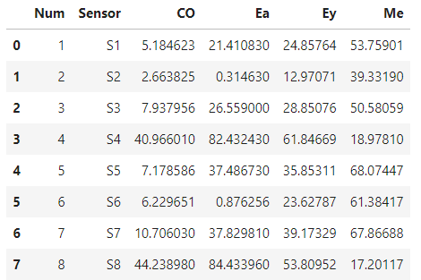
Dataset Dataset Number of sensors= 8 Gases= 4 (Ea: Ethanol, CO: CO, Ey: Ethylene, Me: Methane) Concentration:50 ppm. Repetitions= 1 Board= 1 Duration of experiment=600 seconds Conductivity of each sensor at 100 hz

Slide 4




Stepwise Elimination Method
By applying a leave‐one‐out method to various candidate sensors, the sensor selection based on SE is a technique that eliminates the sensors that have the greatest effect on the selectivity and sensitivity of the sensor array. A sensor is removed repeatedly until there is no more improvement in the sensitivity and selectivity, and finally, the remaining sensors are selected.
The sensitivity (root sum square [RSS]) of each candidate sensor was calculated according to:
The parameter n is the number of gas or the number of patterns and Xc is the response value of the c‐th sensor. In addition, the sensitivity (sum of the root sum square [SRSS]) of the sensor array was obtained by:
The parameter M is the number of sensors included in the array for which the sensitivity is to be calculated. Then, the sensor array selectivity (sum of the Euclidean distance [SED]) was obtained by:
The parameter N is the number of gases and m is the number of sensors.

Slide 5
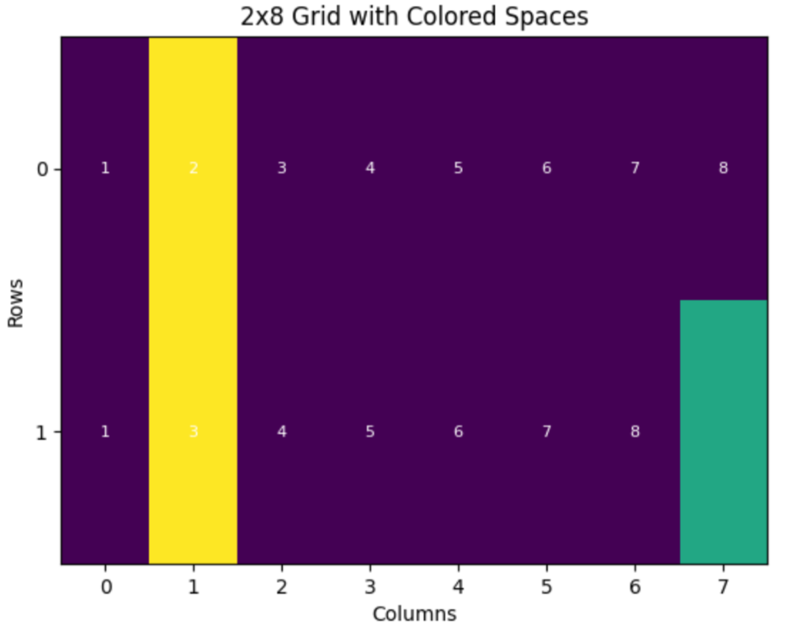
Results of SE on Lab test data
Required sensors for this data:
S1,S4,S5,S6,S7,S8
Final Values(without removing any sensor). SED : 165.21821395808576,
SRSS : 221.94695156775916,
AVG : 193.58258276292247
After removing 2nd sensor:
After removing 3rd sensor:
After this the value of average is decreasing ,since
there is no more improvement in avg only two
Sensors will be removed and other six will be our
required sensors.

Slide 6
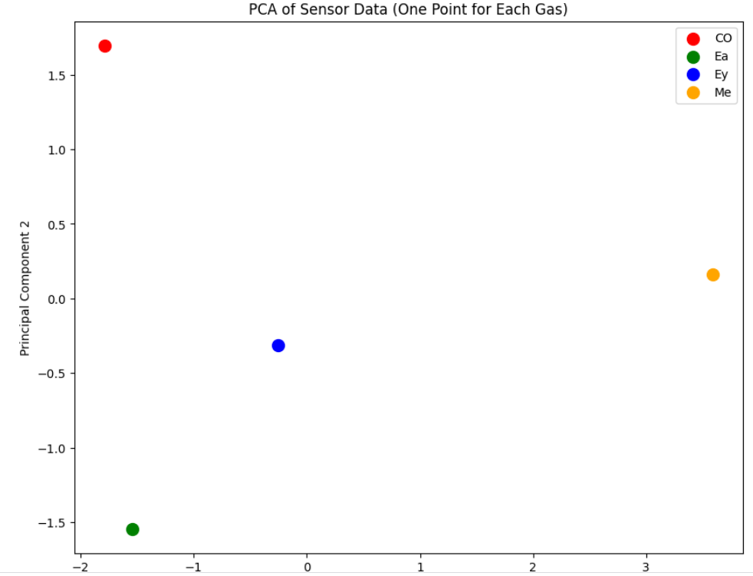
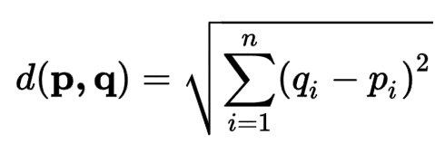
PCA plot and Euclidean distances between them. Euclidean distances between gas pairs: CO-Ea: 3.25 CO-Ey: 2.52 CO-Me: 5.59 Ea-Ey: 1.78 Ea-Me: 5.40 Ey-Me: 3.87

Slide 7



Wilks Lambda Method
Wilks lambda is defined as :
The parameter B is a matrix indicating how the mean vector of each group is spread out from the overall mean vector.
The parameter g is the number of groups (sensors) and ni is the number of patterns that belong to the i‐th group. The parameter xi is the mean of the i‐th group and x is the overall mean..The parameter W is a matrix indicating how the data vectors of each group are spread out from the average vector of the group and represents the variance within the group.
The parameter xij is the value of the j‐th sensor of the i‐th group.
.

Slide 8


.
The parameter Λ(m) is expressed as follows:
Then, the right‐hand term is separated and shown as U(m), where m is the sensor. The parameter U(m) is a value obtained by dividing the variance within the group of each sensor by the total variance of each sensor, and the closer the value is to 1, the greater the discriminative power of the sensor

Slide 9

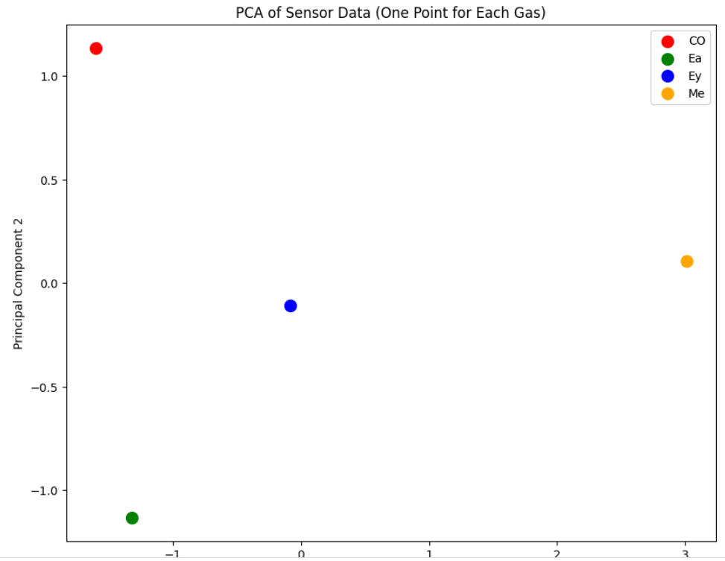
Required sensors:
Other four sensors are eliminated
because their U(m) values were
much smaller.
Euclidean distances between gas pairs: PCA Plot
CO-Ea: 2.29
CO-Ey: 1.96
CO-Me: 4.73
Ea-Ey: 1.61
Ea-Me:4.5
Ey-Me: 3.10

Slide 10
What is Principal Component Analysis?
Principal Component Analysis (PCA) is a statistical procedure that uses an orthogonal transformation that converts a set of correlated variables to a set of uncorrelated variables. PCA is the most widely used tool in exploratory data analysis and in machine learning for predictive models. Moreover,
Principal Component Analysis (PCA) is an unsupervised learning algorithm technique used to examine the interrelations among a set of variables. It is also known as a general factor analysis where regression determines a line of best fit.
The main goal of Principal Component Analysis (PCA) is to reduce the dimensionality of a dataset while preserving the most important patterns or relationships between the variables without any prior knowledge of the target variables.

Slide 11
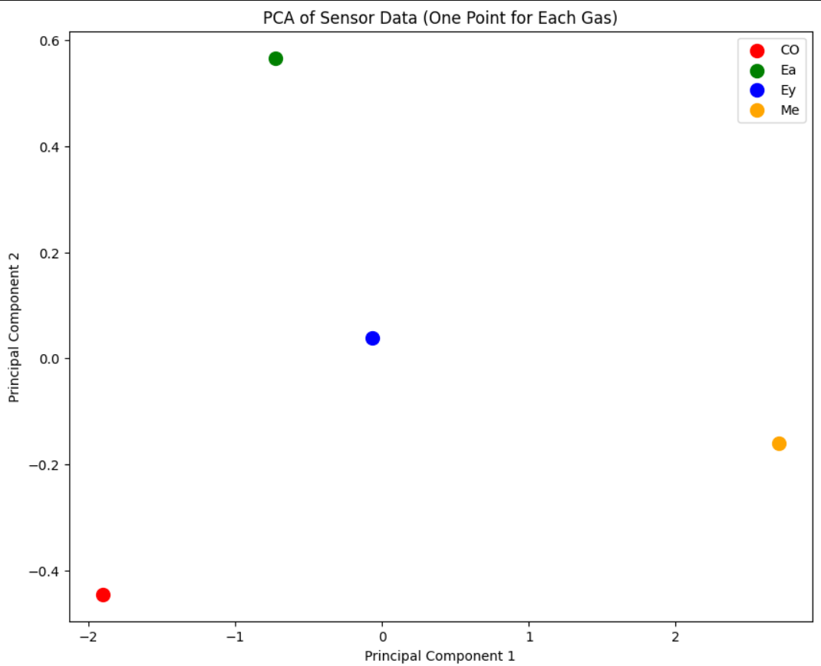
B4 (technique based on principal components)
The objective is to select the sensors
having eigenvalues more than the threshold value(0.7 in our case)
Eigenvalues:
3050.287215700699 347.51342518266307 10.042780141477497
Only three sensors crossed the threshold.
Required sensors are
['S1', 'S2', 'S3']

Slide 12
Euclidean distances between gas pairs:
CO-Ea: 1.55
CO-Ey: 1.90
CO-Me: 4.61
Ea-Ey: 0.85
Ea-Me: 3.51
Ey-Me: 2.77

Slide 13
Comparison of results of SE,B4,Wilks lambda using euclidean distance
Gases | SE | B4 | Wilks lambda
CO-Ea | 3.25 | 1.55 | 1.88
CO-Ey | 2.52 | 1.9 | 2.03
CO-Me | 5.59 | 4.61 | 4.64
Ea-Ey | 1.78 | 0.85 | 0.83
Ea-Me | 5.4 | 3.51 | 3.3
Ey-Me | 3.87 | 2.77 | 2.68

Slide 14
CONCLUSION
When comparing the PCA results of each technique, the discrimination power of the SE technique was the best. However, because this result was not objective, the ED of the data measured in the array obtained by each technique was calculated. Hence, stepwise-elimination is the best technique to distinguish between the gases. We can easily discriminate ethanol for this mixture of the four gases using SE method, which is our target gas.(3.25+1.78+5.4=10.43),which is the most among all techniques.

